Slide 1


CLIENT ACCOUNT SYSTEM
OCEAN - GROUP 6

Slide 2

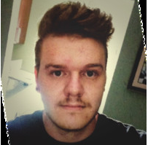
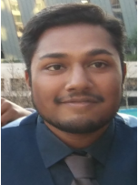
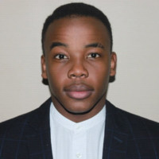
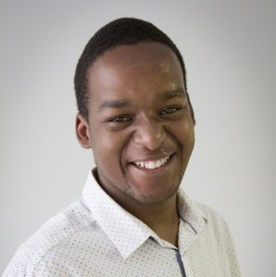
MEET THE TEAM
WALDO
VAN DER MERWE
BAVEN PAVADEY
THABO NTSOANE
BANDILE DLAMINI
LEBOGANG NTLATLENG
Database set up & Unit Testing
DB functions & Unit Testing
User Interface & Integration
Server Creation and hosting
Integration & Unit Testing

Slide 3
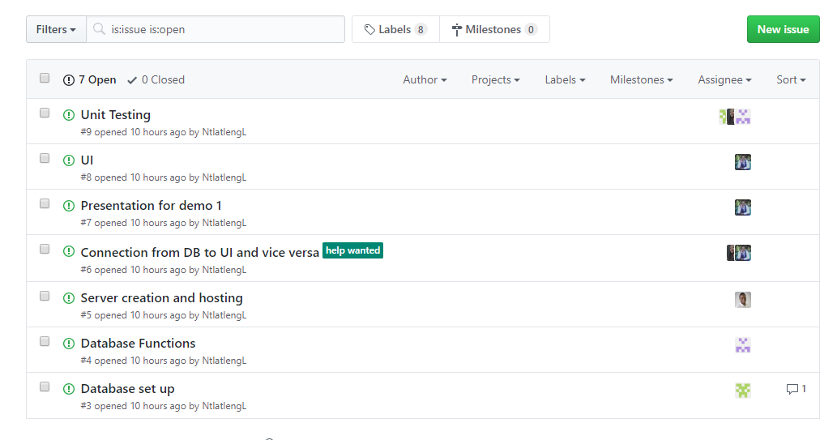
PROJECT MANAGEMENT TOOL
WE USED GITHUB AS OUR PMT BY CREATING ISSUES THAT NEED TO BE RESOLVED

Slide 4
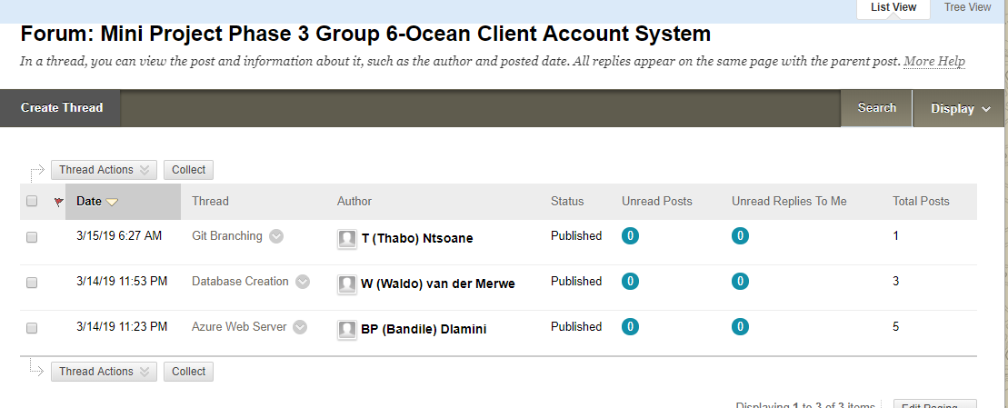
COMMUNICATION
WE USED CLICKUP DISCUSSION FORUM TO COMMUNICATE

Slide 5
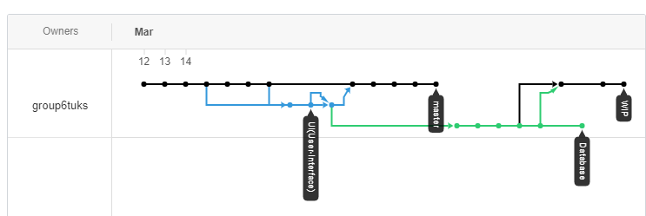
GIT STRUCTURE

Slide 6
UNIT TESTING FUNCTIONS

Slide 7
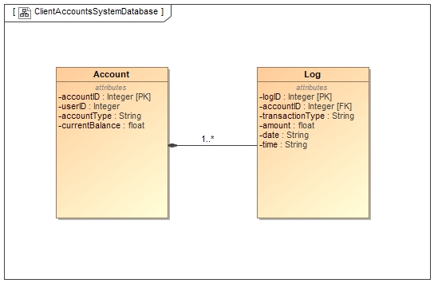
USE CASE

